Slide 1
Welcome to the Monthly KESA Updates and Support Meeting!
This session is scheduled to start promptly at 9:00 a.m.

Slide 2
Kansas Education System Accreditation (KESA) Update – October 12, 2021
Notes:
Welcome everyone to the KESA Update for February. I am glad to see and be able to visit with you today. (next slide)

Slide 3
Today’s Purpose
Walk-through the updated KESA Application
Provide information on the KESA Regional Support and Training Pilot
Answer any of your questions
Notes:
The purpose of this month’s KESA Update is two-fold:
Provide you with an opportunity to see and ask questions about the Revised KESA Application. As we do this I will attempt to answer questions like:
What do the new reports look?
How is compliance going to be reported?
Where do my goals go?
What happened to my reports…I can’t find them?
Provide clarifying information on the KESA Regional Support and Training Pilot

Slide 4
KESA Application
Notes:
Still accessed through the Authenticated Application

Slide 5
KESA Regional Support
Notes:
Still accessed through the Authenticated Application

Slide 6
Questions regarding a "new KESA pilot”. To clarify, beginning this fall a few of the most recently accredited systems who are beginning a second cycle volunteered to engage in intentional professional learning opportunities.
The intention is to align language across all school improvement processes supported by our agency. It is an opportunity for KSDE to obtain feedback relative to the overall continuous improvement process (data analysis, goal setting, strategy selection, strategy implementation, and strategy analysis), and consider a regional support model for all systems in the future.

Slide 7
Purpose - KESA Regional Support
KSDE is aligning continuous improvement processes.
KSDE is aligning language.
What will it be called?
It will be called KESA!
Notes:
Language Alignment

Slide 8
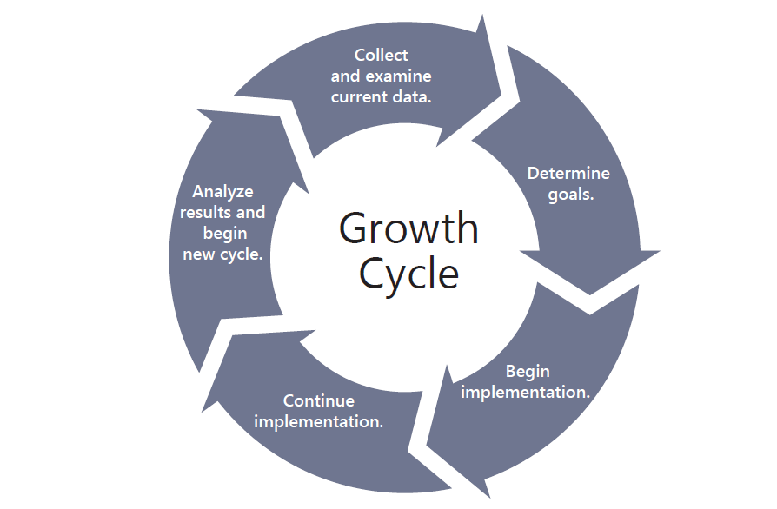
Data Analysis
Strategy Analysis
Set Goals
Strategy Implementation
Strategy Selection

Slide 9
Data
Analysis
Set Goals
Strategy Selection
Strategy Analysis
Strategy Implementation

Slide 10
General Reminder
Notes:
Still accessed through the Authenticated Application

Slide 12
2021-2022 Monthly KESA Updates
Tuesday, October 12, 2021
Tuesday, November 9, 2021
Tuesday, December 14, 2021
Tuesday, January 11, 2022
Tuesday, February 8, 2022
Tuesday, March 8, 2022
All KESA monthly updates are done via Zoom and recorded. They are scheduled from 9:00 – 10:00 a.m. on the dates listed above.
Registration: https://ksde.zoom.us/meeting/register/tZMpfu6prDgqG9NdArF0ovR2otXJyBq0U_Oe
Notes:
Please mark your calendars for next year’s KESA Updates. A reminder with the dates, time and zoom link for registration will be sent out in August.

Slide 13
Questions? Thank You!

Slide 14
Dr. Mischel D. Miller Director Teacher Licensure and Accreditation (785) 296-8010 mmiller@ksde.org
Jeannette Nobo
Assistant Director- KESA Teacher Licensure and Accreditation (785) 296-4948 jnobo@ksde.org
Myron Melton
KESA Coordinator
Teacher Licensure and Accreditation
(785) 296-8110
mmelton@ksde.org
John Girodat
Education Program Consultant - KESA
Teacher Licensure and Accreditation
(785) 368-7356
jgirodat@ksde.org
Ed Kalas, Education Program consultant
Professional Learning and Mentoring
Teacher Licensure and Accreditation
(785) 296-2198
ekalas@ksde.org

